Slide 1
Market Basket Analysis

Slide 2
Agenda:
Agenda of this project is to use statistical methods to understand sales pattern and trends of sales of different product, based on the past 3 years of data. This is done through exploratory data analysis conducted using Tableau and Market Basket Analysis conducted through KNIME. On finding the insights recommendations are made on developing a better marketing and sales strategy.
Problem Statement
Exploratory Data Analysis
Market Basket Analysis
Inferences and Recommendation

Slide 3
Problem Statement:
A Grocery Store shared the transactional data with you. Your job is to identify the most popular combos that can be suggested to the Grocery Store chain after a thorough analysis of the most commonly occurring sets of menu items in the customer orders. The Store doesn’t have any combo meals. Can you suggest the best combo meals?
Exploratory Analysis
Exploratory Analysis of data & an executive summary (in PPT) of your top findings, supported by graphs.
Are there trends across months/years/quarters/days etc. that you are able to notice?
Use of Market Basket Analysis (Association Rules)
Write Something about the association rules and their relevance in this case
Add KNIME workflow Image
Write about threshold values of Support and Confidence
Associations Identified
Put the associations in a tabular manner
Explain about support, confidence, & lift values that are calculated
A suggestion of Possible Combos with Lucrative Offers
Write recommendations
Make discount offers or combos (or buy two get one free) based on the associations and your experience

Slide 4
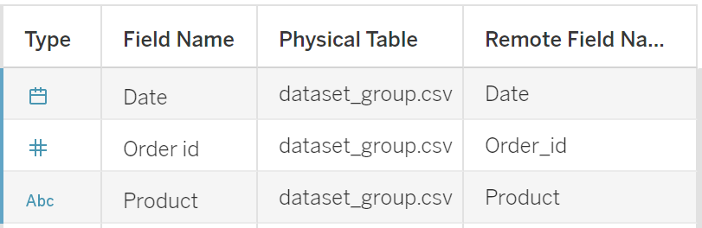
EDA: About the data
There are 20641 rows and 3 columns (Date, Order ID, Product)
There are no missing values
The three columns are as follows:
Date is of date type, Order_id is a number and Product is of string type
There are duplicated values but they have not been removed as it might reflect that the product was bought the number of times it appears.
The data is for three years i.e. 2018, 2019 and 2020 (February of 2020)
There are 37 unique product

Slide 5
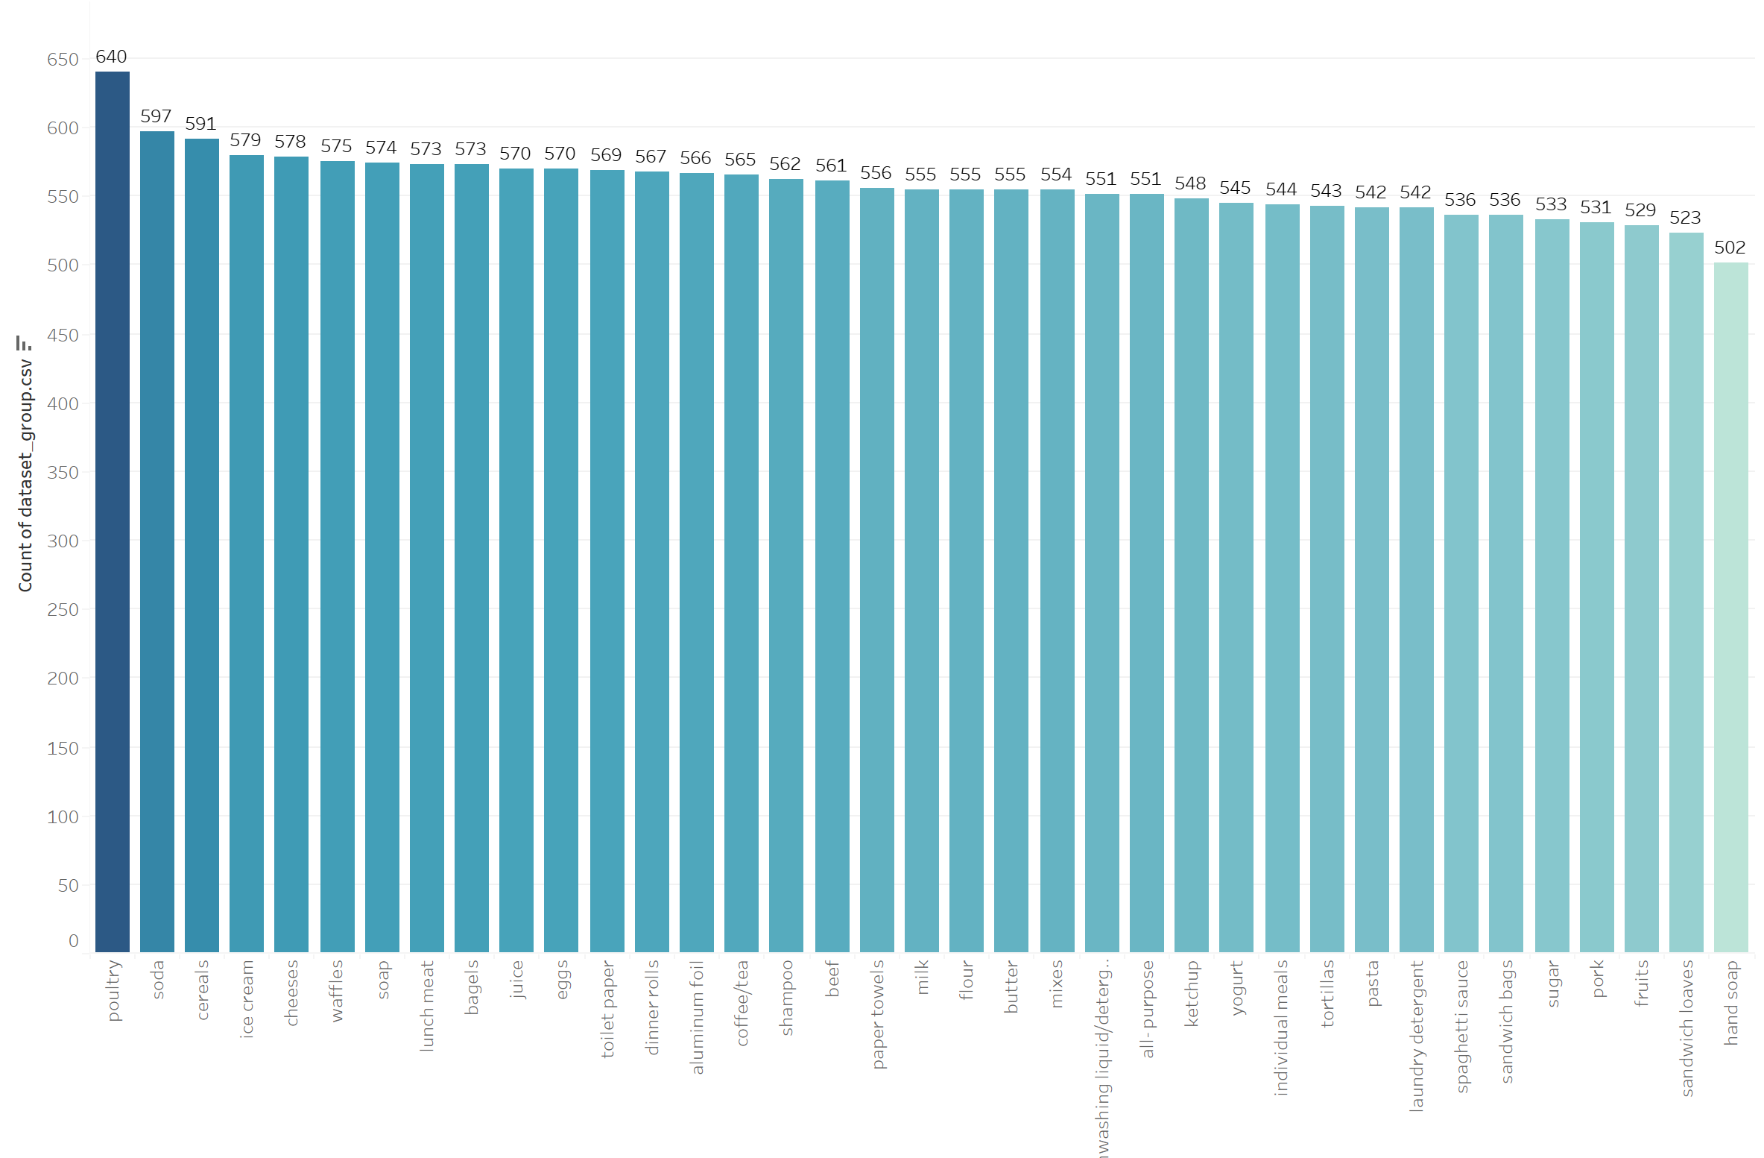
EDA: Sales amount Tableau link: MRA 2 | Tableau Public
Poultry is the most frequently bought item followed by Soda and Cereals.

Slide 6
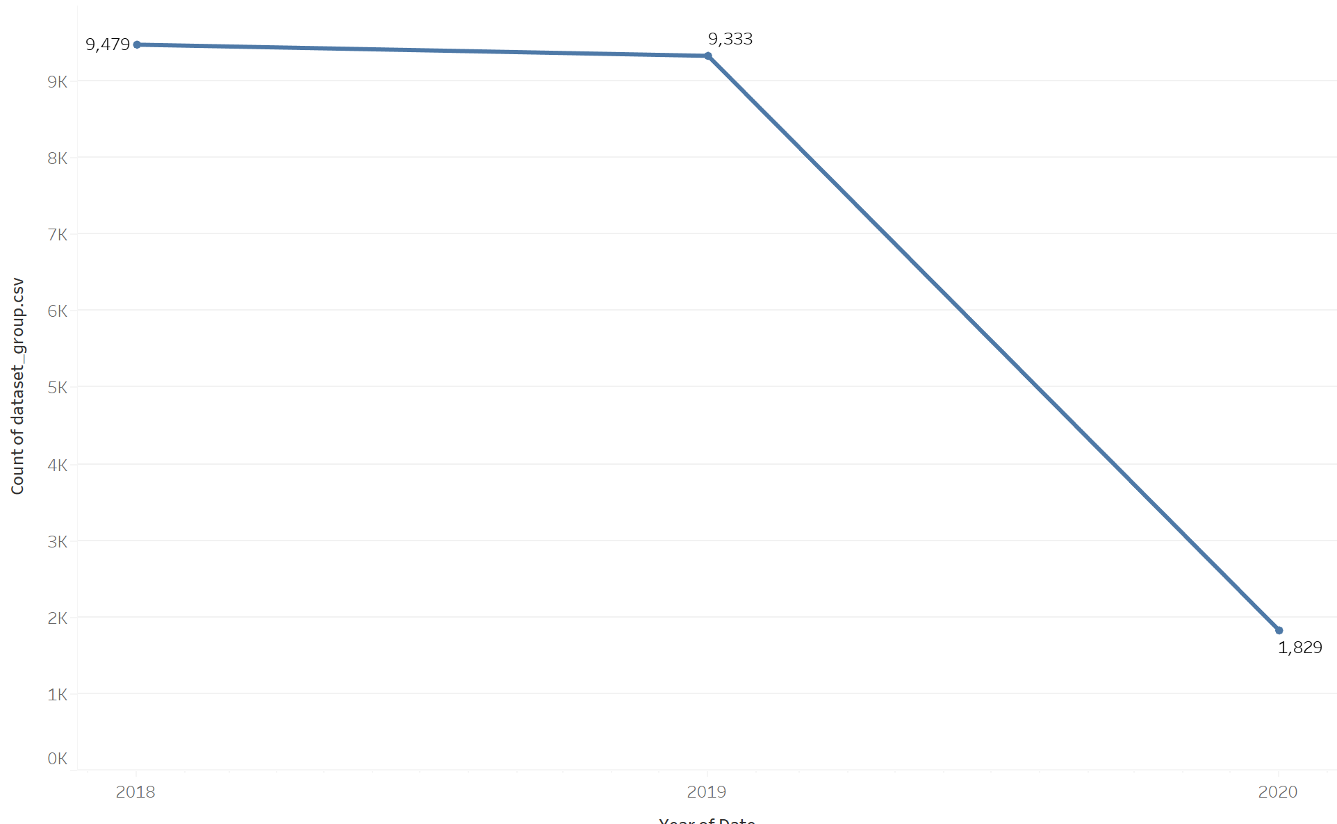
Yearly Sales
The yearly sales was good from 2018 to 2019 but it drastically reduced in 2020

Slide 7
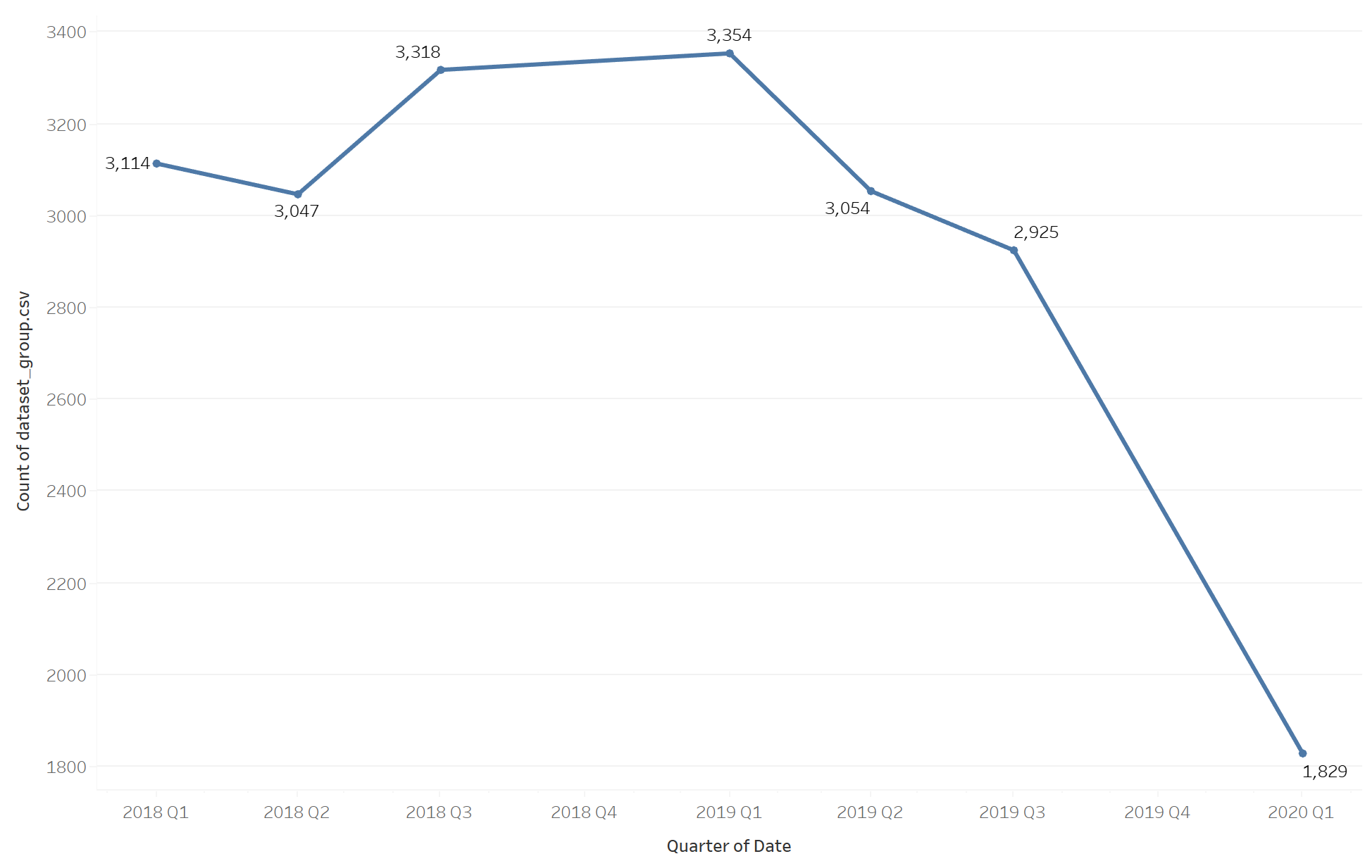
Quarterly sales
The sales seems to highest from Q3 of 2018 to Q1 of 2019, after which the sales starts decreasing
There’s a sharp decline in sales from Q3 of 2019 to Q1 of 2020

Slide 8
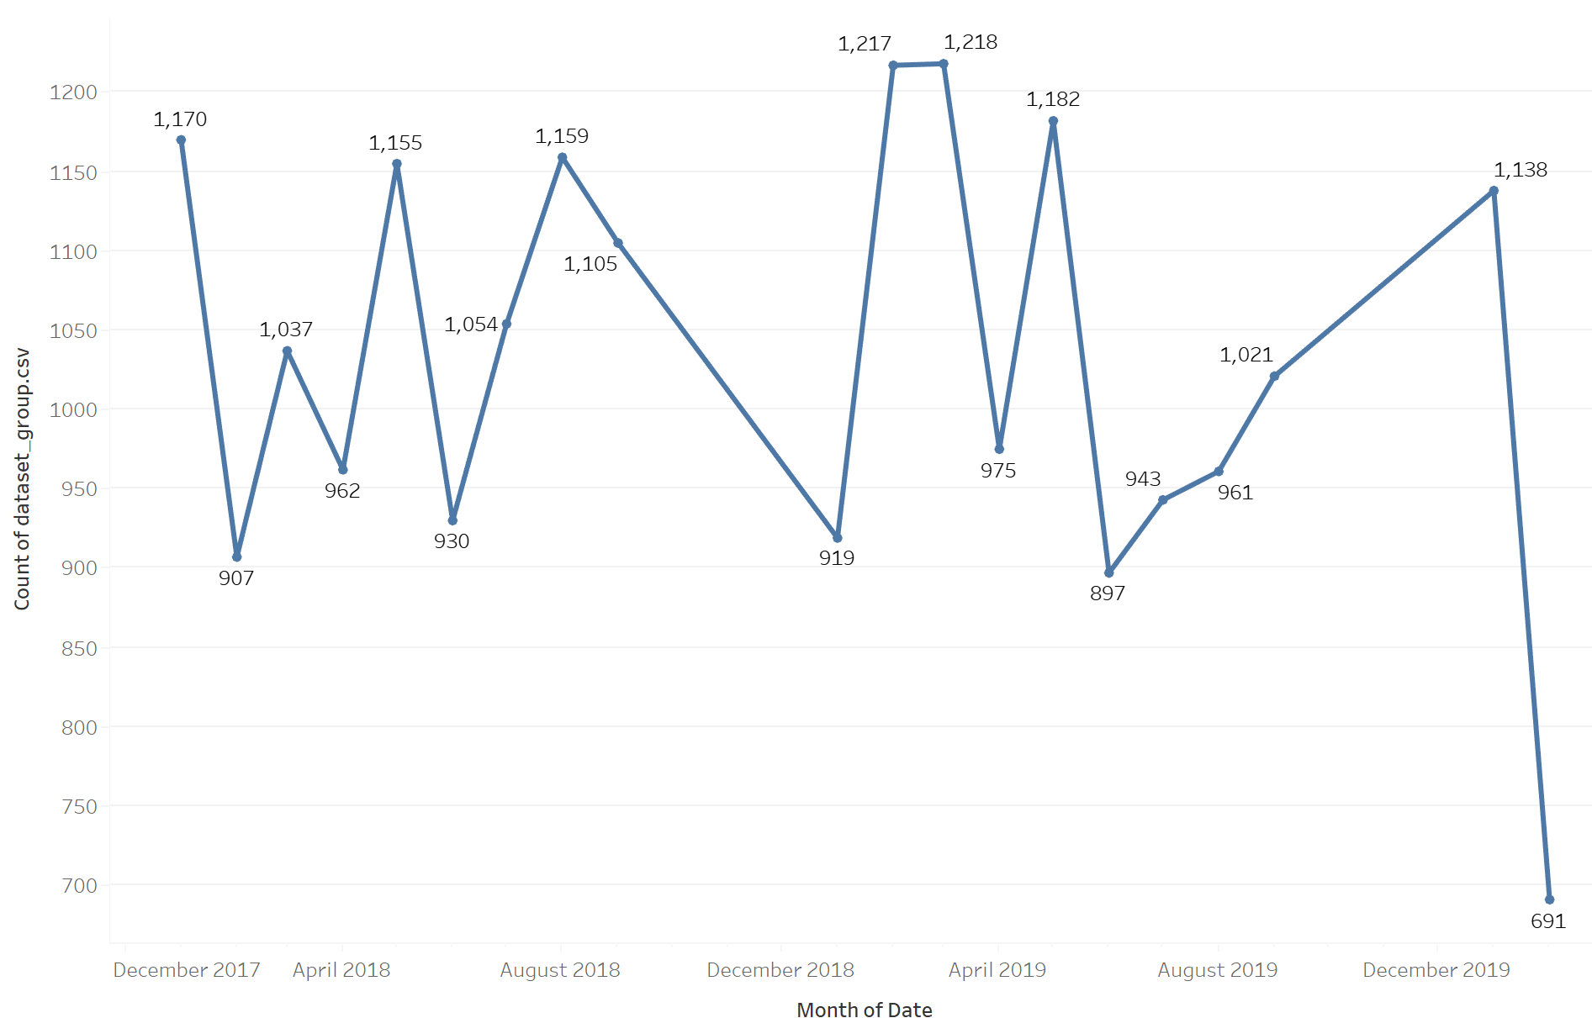
Monthly Sales
There seems to be lot of fluctuation in the monthly sales, with every alternate month showing opposite trend
May of 2018 and 2019 seems to have good sales while June of both years have declined sales
Monthly sales were increasing from June 2019 to January 2020, after which there was a sharp drop in sales

Slide 9
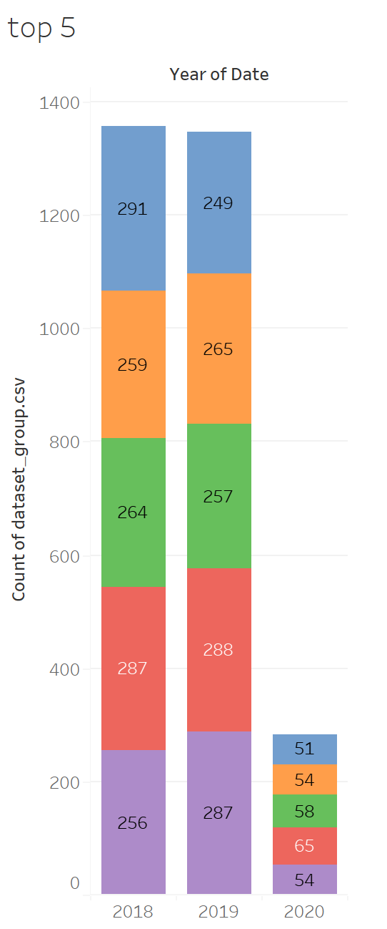
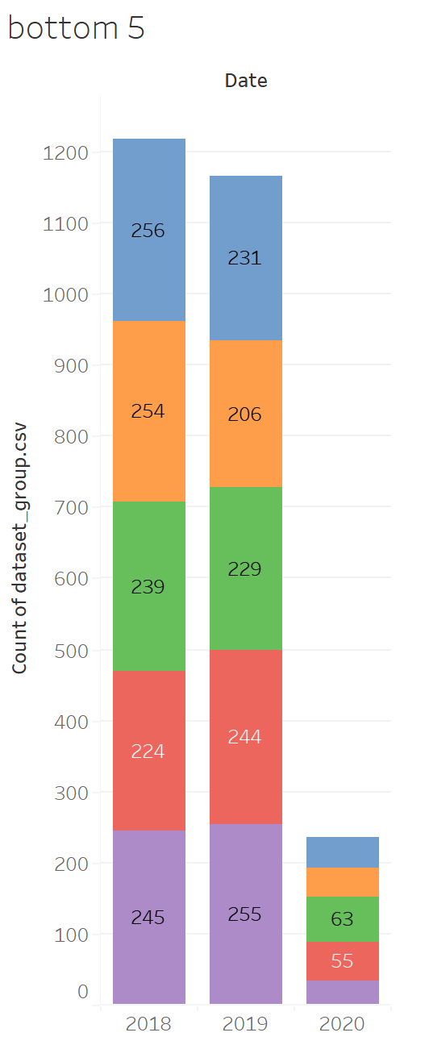
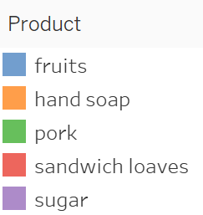
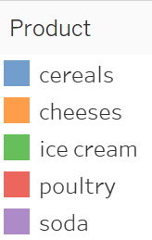
Top 5 and Bottom 5 Products
The top item for each year are as follows-
2018- cereals
2019- Soda
2020-Poultry
The bottom item for each year are-
2018- Sandwich loaves
2019-handsoap
2020- sugar

Slide 10
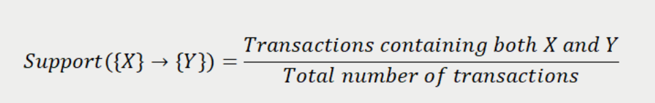
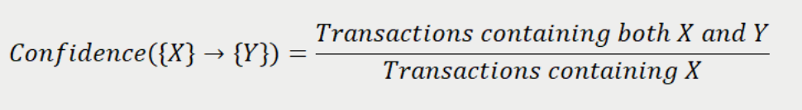
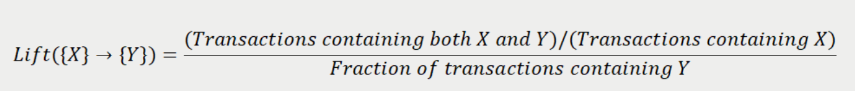
Market Basket Analysis
Market basket analysis is a data mining technique used by retailers to increase sales by better understanding customer purchasing patterns. It works by looking for combinations of items that occur together frequently in transactions. The statistical method used to measure and find the combinations items is called ‘Association Rule’ which helps in discovering interesting relations between variables in large databases. It main components are:
Support - This measure gives an idea of how frequent an itemset is in all the transactions. Value of support helps us identify the rules worth considering for further analysis. Mathematically, support is the fraction of the total number of transactions in which the itemset occurs.
Confidence – It measures the likeliness of occurrence of consequent on the cart given that the cart already has the antecedents. Technically, confidence is the conditional probability of occurrence of consequent given the antecedent.
Lift- Ratio of confidence to expected confidence. It gives 'lift' to our confidence and helps in knowing that whether calculate probability of having the item in the cart is reliable or not. Higher the lift, better the rule to be chosen for predicting the next item for cart.

Slide 11
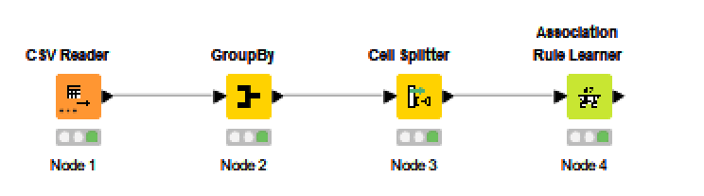
KNIME flow
Support is set at 0.049 with confidence of 0.60.
This gives us 37 rules

Slide 12
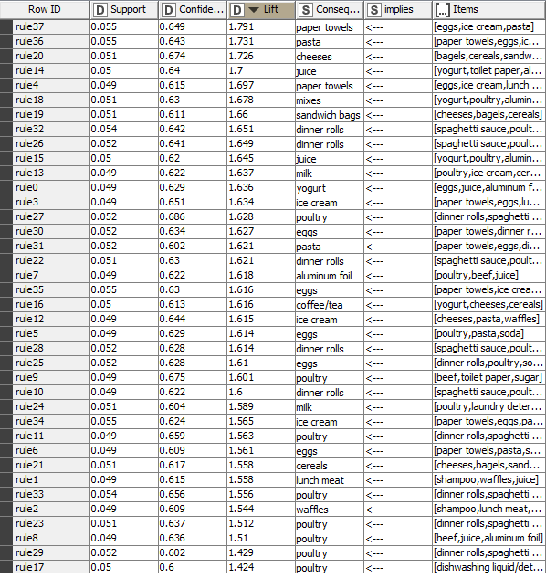
Association Rule output
The data is sorted in descending order of Lift

Slide 13
Interpreting Rules 1 and 0
Rule 0
The support is 0.049, i.e. 4.9% of customer bought eggs, juice and aluminium foil
The confidence is 0.629, i.e. 62.9% of customer who bought eggs, juice and aluminium foil also bought yogurt
The lift is 1.636, i.e. there is 63.6% expectation that people will buy yoghurt when they have bought eggs, juice and aluminium foil
Rule 1
The support is 0.049, i.e. 4.9% of customer bought shampoo, waffles and juice
The confidence is 0.615, i.e. 61.5% of customer who bought shampoo, waffles and juice also bought lunch meat
The lift is 1.558, i.e. there is 55.8% expectation that people will buy lunch meat when they have bought shampoo, waffles and juice

Slide 14
Taking top 2 rules (Based on highest lift)
Rule 37
The support is 0.055, i.e. 5.5% of customer bought eggs, ice cream and pasta
The confidence is 0.649, i.e. 64.9% of customer who bought eggs, ice cream and pasta also bought paper towels
The lift is 1.731, i.e. there is 73.1% expectation that people will buy paper towel when they have bought eggs, ice cream and pasta
Rule 36
The support is 0.055, i.e. 5.5% of customer bought paper towel, eggs and ice cream
The confidence is 0.643, i.e. 64.3% of customer who bought paper towel, eggs and ice cream also bought pasta
The lift is 1.731, i.e. there is 77.3% expectation that people will buy pasta when they have bought paper towel, eggs and ice cream

Slide 15
Recommendation
There should discount offers or combo plans on least sold and perishable products
Most of the time poultry and dinner rolls and eggs are recommended when people have bought bunch of stuff. We can use this fact to devise more combo offer with these three products.
Combo offers can be used for following products-
sandwich bag and cheese
ice cream and milk
poultry and eggs
milk and cereal
Discounts can be offered for the following products-
cheese and bagels – 5%
poultry and egg- 10%
ice cream and waffles- 5%
milk and ice cream- 5%

